Slide 1
Transformations: Rotations
www.achildsguideto.com

Slide 2
Describe fully the transformation that maps shape A to shape B.
There are usually three marks for this type of question:
Rotation
Clockwise or Counter clockwise by 90°, 180° or 270°
About the centre of rotation (x,y) where x and y are the co-ordinates of the rotation.

Slide 3
Q1: Rotate the arrow 90° clockwise about the centre of rotation indicated by the cross.
The centre of rotation touches the point of the arrow.
The centre of rotation touches the point of the arrow.

Slide 4
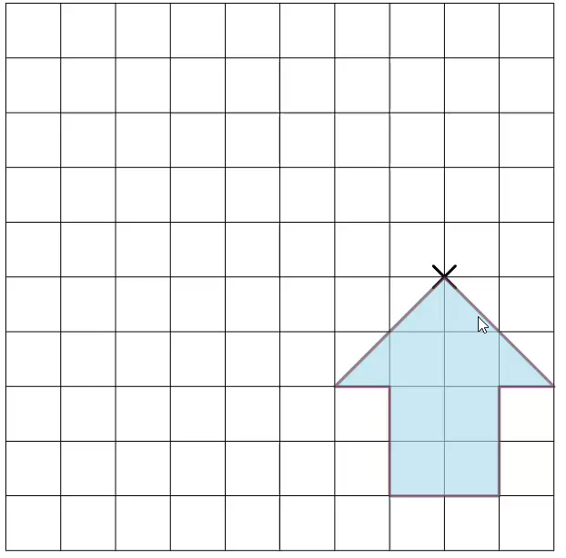

Slide 5
Q2: Rotate the arrow 90° clockwise about the centre of rotation indicated by the cross.
The cross is one box above the green arrow
The cross is one box to the right of the arrow

Slide 6
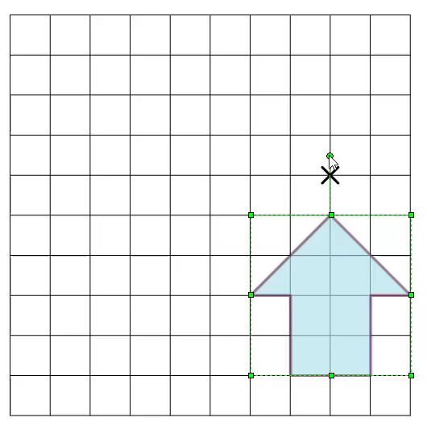

Slide 7
Q3: Rotate the arrow 90° clockwise about the centre of rotation indicated by the cross.
The cross is two boxes above the green arrow
The cross is two boxes to the right of the green arrow

Slide 8
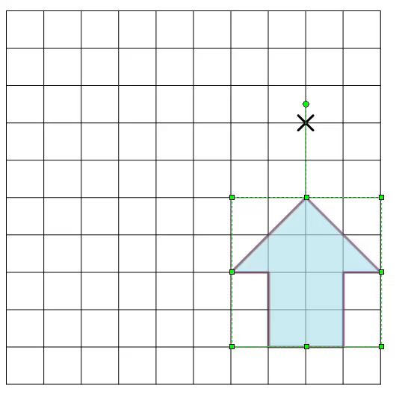

Slide 9
Q4: Rotate the arrow 90° clockwise about the centre of rotation indicated by the cross.

Slide 10
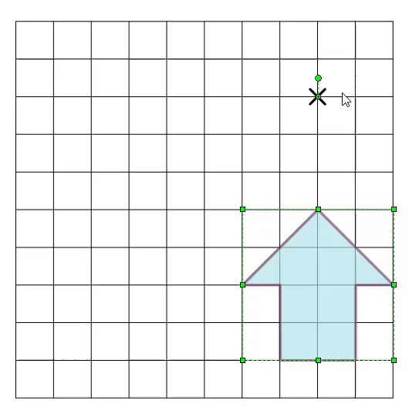

Slide 11
Q5: Rotate the arrow 90° clockwise about the centre of rotation indicated by the cross.

Slide 12
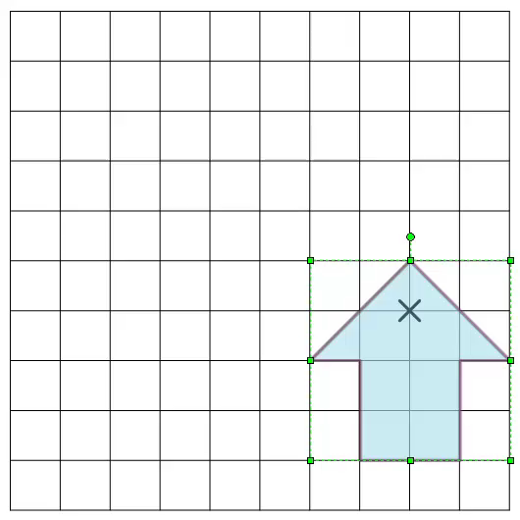

Slide 13
Q6: Rotate the arrow 90° clockwise about the centre of rotation indicated by the cross.

Slide 14
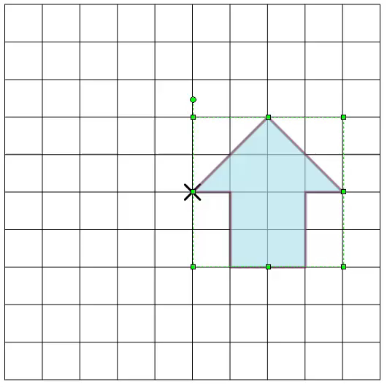

Slide 15
Q7: Rotate the arrow 90° clockwise about the centre of rotation indicated by the cross.

Slide 16
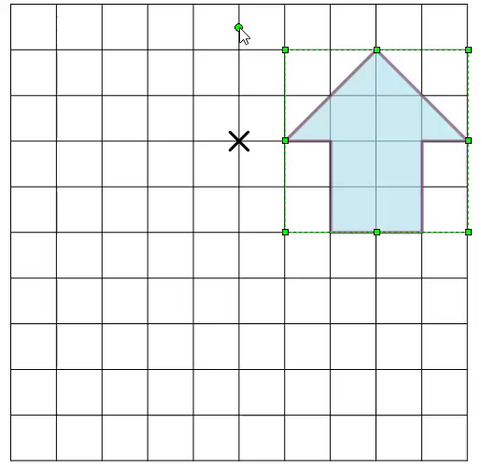

Slide 17
Q8: Rotate the arrow 90° clockwise about the centre of rotation indicated by the cross.

Slide 18
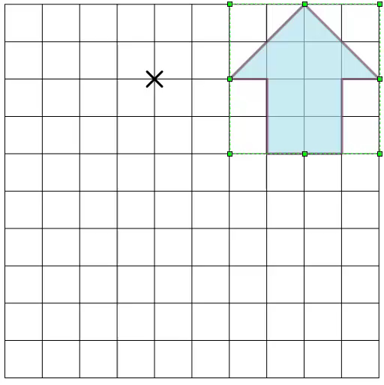

Slide 19
Q9: Rotate the arrow 90° clockwise about the centre of rotation indicated by the cross.

Slide 20
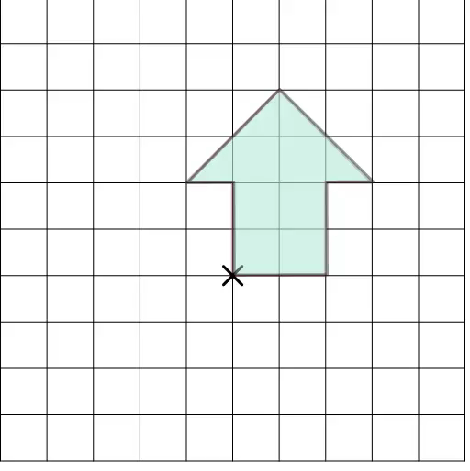

Slide 21
Q10: Rotate the arrow 90° clockwise about the centre of rotation indicated by the cross.

Slide 22
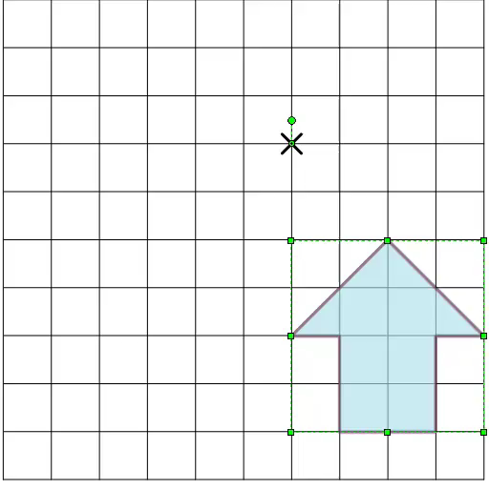

Slide 23
Q11: Rotate the arrow 90° clockwise about the centre of rotation indicated by the cross.

Slide 24
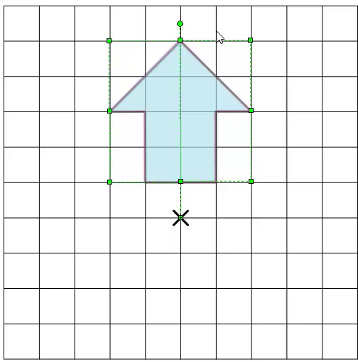

Slide 25
Q12: Rotate the arrow 90° clockwise about the centre of rotation indicated by the cross.

Slide 26
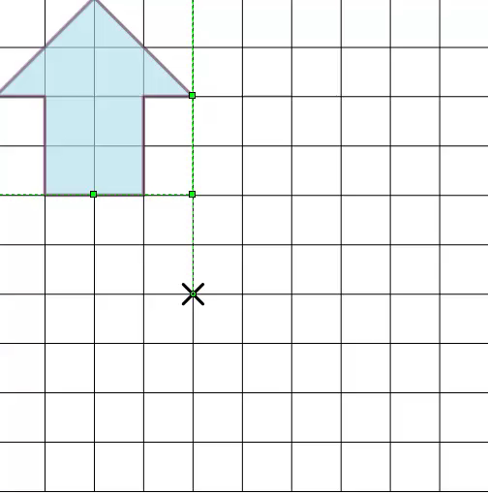

Slide 27
Which of the following describes the transformation from green to blue on the left most accurately?
Rotation CW 90° about the centre of rotation (4,7).
Rotation CW 90° about the centre of rotation (7,4).
Rotation CW 270° about the centre of rotation (7,4).

Slide 28
Which of the following describes the transformation from green to blue on the left most accurately?
Rotation CCW 90° about the centre of rotation (3,5).
Rotation CW 90° about the centre of rotation (5,3).
Rotation CCW 90° about the centre of rotation (5,3).

Slide 29
Which of the following describes the transformation from green to blue on the left most accurately?
Rotation CCW 90° about the centre of rotation (1,4).
Rotation CW 270° about the centre of rotation (5,5).
Rotation CW 270° about the centre of rotation (2,2).

Slide 30
Which of the following describes the transformation from green to blue on the left most accurately?
Rotation CW 270° about the centre of rotation (3,4).
Rotation CW 270° about the centre of rotation (4,4).
Rotation CW 270° about the centre of rotation (5,4).

Slide 31
Which of the following describes the transformation from green to blue on the left most accurately?
Rotation CW 90° about the centre of rotation (7,2).
Rotation CW 90° about the centre of rotation (2,7).
Rotation CW 90° about the centre of rotation (6,3).

Slide 32
Which of the following describes the transformation from green to blue on the left most accurately?
Rotation CW 180° about the centre of rotation (2,2).
Rotation CW 180° about the centre of rotation (4,4).
Rotation CW 180° about the centre of rotation (6,6).

Slide 33
Which of the following describes the transformation from green to blue on the left most accurately?
Rotation CW 180° about the centre of rotation (3½, 3½,).
Rotation CCW 180° about the centre of rotation (4½, 3½,).
Rotation CW 180° about the centre of rotation (5½,4½,).

Slide 34
Which of the following describes the transformation from green to blue on the left most accurately?
Rotation CW 90° about the centre of rotation (2,3).
Rotation CCW 90° about the centre of rotation (6,7).
Rotation CW 90° about the centre of rotation (1,2).

Slide 35
You have finished the slide show
In the exam you will be able to use tracing paper which might make answering the questions easier.

Slide 36
Incorrect. Try again.
Try to visualise the rotation about the point mentioned in your head.

Slide 37
You got question 1 correct !!
Well done

Slide 38
You got question 2 correct !!
The same corner for each image was overlapping. That usually means that that corner is at the centre of rotation.

Slide 39
You got question 3 correct !!
If you can make the same shape L from where you think the centre of rotation is to the same vertex on each shape, you are likely to be correct.

Slide 40
You got question 4 correct !!
If you extend the base line of the green arrow to the left and extend the base line of the blue arrow down, where they cross is the centre of rotation.

Slide 41
You got question 5 correct !!
The same corner for each image was overlapping. That usually means that that corner is at the centre of rotation.

Slide 42
You got question 6 correct !!
In the exam, if the rotation is 180°, you can draw a line from one of the vertices in one shape to the corresponding vertex in the other. Do this with two different vertices and the point where the lines cross is your centre of rotation.

Slide 43
You got question 7 correct !!
Again, if the rotation is 180°, you can draw a line from one of the vertices in one shape to the corresponding vertex in the other. Do this with two different vertices and the point where the lines cross is your centre of rotation.

Slide 44
You got question 8 correct !!
The line of symmetry for both shapes cross at the point (1,2). This gives us the clue we need to determine the centre of rotation.

